Slide 1

MINI PROJECT
ON
FACE RECOGNITION SYSTEM WITH
FACE DETECTION
Under the guidance of
Dr. Jyoti Gupta
Assistant Professor of E.C.E dept
ABHINANDAN KUMAR ( 00151207320)
PULKIT VERMA ( 00951207320)
SAGAR ( 01151207320)
SANIYA EHTESHAM (01251207320)
19 May 2022 MINI PROJECT 2022 1

Slide 2
INTRODUCTION
The goal of this effort is to develop new algorithm for face recognition that overcome many of the limitation found in existing facial recognition systems. Specially, we are interested in addressing the problem of detecting faces in color images in the presence of various lighting condition and complex backgrounds as well as recognizing faces under variations in pose, lighting, and expression. This work is separated into two major components;
Face Detection and
Face recognition: Specific tasks include developing modules for face detection, pose estimation, face modeling, face matching, and a user interface.
19 May 2022 MINI PROJECT 2022 2

Slide 3
PROBLEM STATMENT
Maximum works were proposed the Face Recognition system in particular case(Either Pose or Illumination or specific Face Database).
Till date there is no single face recognition system for fulfilling the all (or Maximum factors) in real time application.
Every method has its pros and cons. The presenter motivated by the unsatisfactory scenario of Face Recognition system to enhance the performance of it.
Given still images of a scene, identify or verify one or more persons in the scene using a stored database of faces.
19 May 2022 MINI PROJECT 2022 3

Slide 4
Face Detection Face Recognition
We have developed a face detection system from color images using a skin-tone color model and facial features. Major facial features are located automatically and color bias is corrected by a lighting compensation technique that automatically estimates the reference white pixels.
The problem of face recognition in a general situations(arbitrary pose, lighting and facial expression) is a very difficult problem. In this project we have successfully investigated a verify of different approaches for achieving our goals in face recognition.
19 May 2022 MINI PROJECT 2022 4

Slide 5
Functional Requirements
In this we add image by capturing from webcam and store them in our system. During registration image is captured.
We then detect the faces given by the user and then we recognize the faces according to the given database.
Image Capture Module: This module is used to capture image using web camera. This is written as a separate thread to avoid system hanging. This module is used to capture image in login module and registration module.
Eigen face Computation: This module is used to compute the “face space” used for face recognition.
The recognition is actually being carried out in the Face Bundle object, but the preparation of such object requires doing lots of computations.
19 May 2022 MINI PROJECT 2022 5

Slide 6
Software Requirements
Hardware Requirements
PyCharm
PyCharm Prompt
Python
Any OS[Window/Linux]
Window 2000 . Net-Frame: v4.5 Front-end Tools:
C# Open Libraries: Opencv
Pentium 4 Clock Speed : 2.86GHZ Processor
Hard disk: 1GB RAM: 64MB
4 GB RAM
20 GB HDD.
Dual Core processor.
CDROM (installation only). VGA resolution monitor.
Microsoft Window 98/2000/NT with service pack 6/XP with service pack 2/
Window 7 with service pack
19 May 2022 MINI PROJECT 2022 6

Slide 7
LITERATURE SURVEY
S.No | Title | Author | Year | Name of journal | Objective
1. | Face Recognition Using Eigen face Approach. | Marijeta Slavković and Dubravka R.Jevtic | 2020 | Serbian Journal of Electrical Engineering | A face recognition system using the Principal Component Analysis (PCA) algorithm was implemented.
2. | Face recognition/detection by probabilistic decision-based neural network. | Shang-Hung Lin, Sun-Yuan Kung and Long-Ji Lin | 2019 | IEEE Transactions on Neural Networks | A face recognition system, based on probabilistic decision-based neural networks (PDBNN).
3. | Detection of facial component based on SVM classification and invariant features. | Rachid Aliradi, Naima Bouzera, Dr Abdelkrim Meziane | 2013 | Support vector machine(SVM) has been adapted | Succeeds in locating facial features in the facial region exactly.
4. | Ensemble Features Selection in Face Recognition ICMLA 2012 Challenge. | Salem Alelyani, Huan Liu | 2012 | Filter- based features selection | Achieve very high accuracy, 99% distinguish human faces.
5. | Verification of static images by comparing with faces stored in the databases by using various algorithm. | A. S. Tolba and A. H. EL- Baz and A. A. El- Harby | 2005 | Collecting facial profile as Curves | Such as bankcard identification , access control, Mug shots searching , security monitoring are almost done.
19 May 2022 MINI PROJECT 2022 7

Slide 8
WHY CHOOSE FRT OVER OTHER BIOMETRICS
It requires no physical interaction on behalf of user.
It is accurate and allows for high enrollment and verification.
Not require an expert to interpret the comparison result.
Can use our existing infrastructure.
Passive identification.
19 May 2022 MINI PROJECT 2022 8

Slide 9
METHODOLOGY
Data
Acquisition
Feature
Extraction
Classification
MATCH/NO
MATCH
ACCEPT/
REJECT
Block Diagram -1
19 May 2022 MINI PROJECT 2022 9

Slide 10
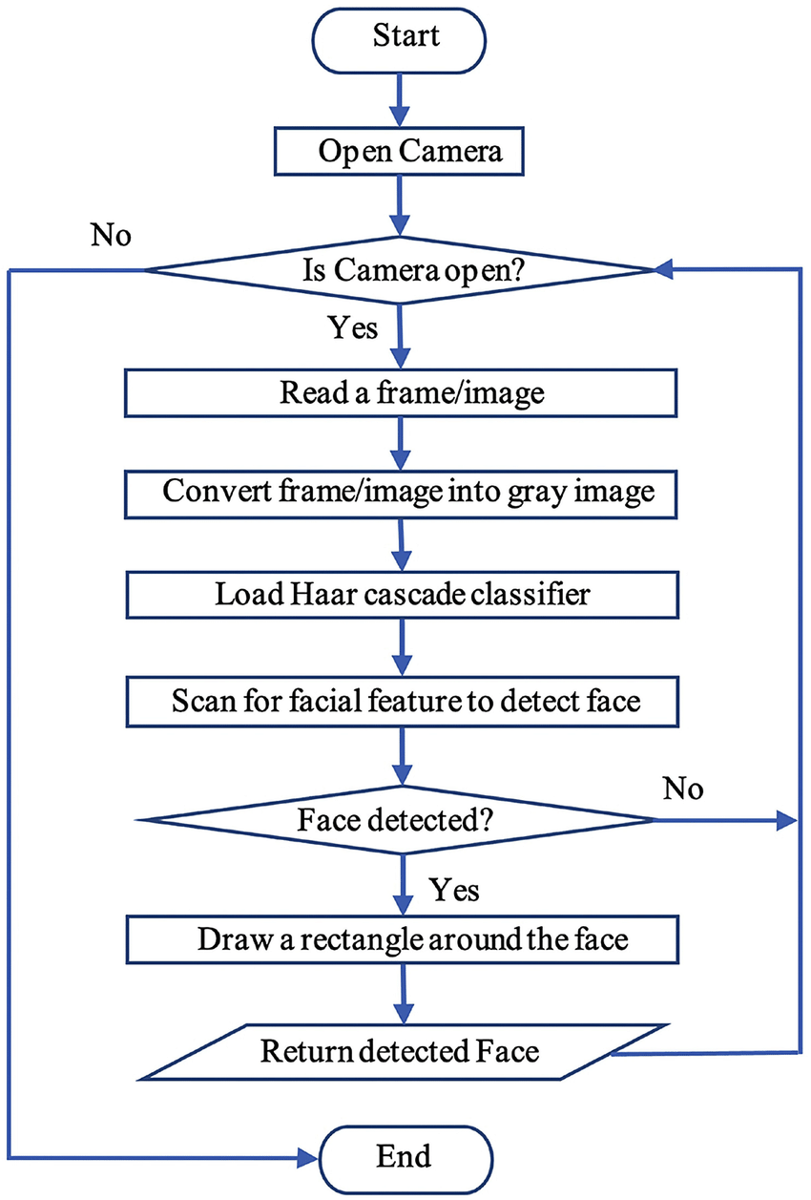
FC-1
19 May 2022 MINI PROJECT 2022 10

Slide 11
IMPLIMENTATION OF FRT
.
IMAGE
PRE-BUILD
MODELS
FACE
DETECTION
FEATURE
EXTRACTION
FACES
DATABASE
FACE
RECOGNITION
Verification and Identification
19 May 2022 MINI PROJECT 2022 11

Slide 12
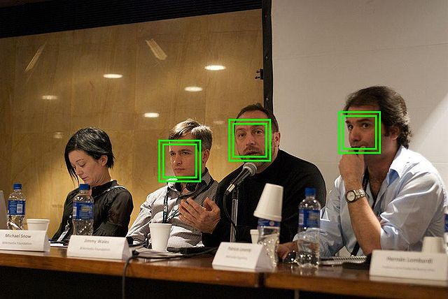
Test Cases[Face-Detection]
INPUT-IMAGE
INPUT-IMAGE
Fig-3
19 May 2022 MINI PROJECT 2022 12

Slide 13
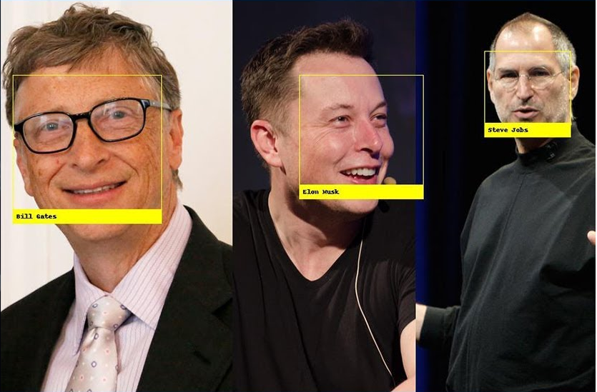
Test Cases[Face-Detection]
OUTPUT-IMAGES
OTPUT-IMAGES
Fig-3
19 May 2022 MINI PROJECT 2022 13

Slide 14
ADVANTAGES
Convenient and social acceptable.
Easy to use and can be used without the knowledge of the prob.
It is very inexpensive and its price should continue to go down.
19 May 2022 MINI PROJECT 2022 14

Slide 15
DISADVANTAGES
Can’t tell the difference between twins.
Imposters can easily authenticate themselves by using clowns.
Low reliability.
Data privacy.
19 May 2022 MINI PROJECT 2022 15

Slide 16
APPLICATIONS
Voting system.
Computer security.
Banking using ATM.
Security in Schools.
Airlines use.
Device security.
Replacement of PINS , physical tokes etc…..
19 May 2022 MINI PROJECT 2022 16

Slide 17
CONCLUSION
Face detection and recognition technology has come a long way in the last twenty year. Today, machines are able to automatically verify identity information for secure transactions, for surveillance and security tasks, and for access control to buildings etc.
These applications usually work in controlled environments and recognition algorithms can take advantage of the environments constraints to obtain high recognition accuracy.
Hence, our project provides useful information to the technical to make essential decision for modern world’s growth.
19 May 2022 MINI PROJECT 2022 17

Slide 18
REFERENCES
[1] G.T. Rado and H. Suhl,International Journal of Soft Computing and Artificial Intelligence(1963), ISSN: 2321-404X, I.S. Jacobs and C.P. Bean, “Fine particles, thin films and exchange anisotropy,” in Magnetism, vol. III, Eds. New York: Academic, , pp. 271-350.
[2] Driver Drowsiness Warning System Using Visual Information for Both Diurnal and Nocturnal Illumination Conditions, . (2010). EURASIP Journal on Advances in Signal Processin.
[3] Jalal, m. (2013). Drowsy Driver Warning System Using Image Processing. INTERNATIONAL JOURNAL OF ENGINEERING DEVELOPMENT AND RESEARCH .
[4] Robertson, D. J. (2015). Face Averages Enhance User Recognition for Smartphone Security. PLoS One.
19 May 2022 MINI PROJECT 2022 18

Slide 19
[5] Gary Bradski, Adrian Kaehler (2008). Learning openCV:computer vision with the opencv Library. "O'Reilly Media, Inc.“
[6] Neetu Saini, Sukhwinder Kaur, Hari Singh(2013). A Review: Face Detection Methods And Algorithms, International Journal of Engineering Research & Technology (IJERT) ISSN: 2278-0181 www.ijert.org Vol. 2 Issue 6.
[7] Smita Tripathi,Varsha Sharma.(2011),” Face Detection using Combined Skin Color Detector and Template Matching Method”. International Journal of Computer Applications Volume 26– No.7.
[8] Kirby and Sirovich, 1990. Application of KarhunenLoeve procedure for the characterization of human faces. IEEE Trans. pattern analysis and machine intelligence, 12:103-108.
19 May 2022 MINI PROJECT 2022 19

Slide 20

19 May 2022 MINI PROJECT 2022 20

